Slide 1

Peer-to-Peer Teaching Summer 2025
“Those who carry torches will help others.”
Sofia Fertuzinhos, PhD and Rolando Garcia-Milian, MLIS
Bioinformatics Support Hub
Cushing/Harvey Medical Library, Yale University

Slide 2


Explore Gene Co-expression with WGCNA package in RStudio.
July 31, 2025
Peer-to-Peer Teaching present:
Beyond gene lists…
Giovana Motta de Oliveira, MSc.

Slide 3




Who am I?
Research Fellow at the Nicoli Lab, Yale Cardiovascular Research Center (YCVRC)
Master’s student in Bioinformatics, University of São Paulo (USP)
Bachelor’s degree in Biology, State University of Campinas (UNICAMP)

Slide 4
Agenda
Background
Gene Correlation Network (GCN)
Components
Workflow
Good practices
Practice section

Slide 5
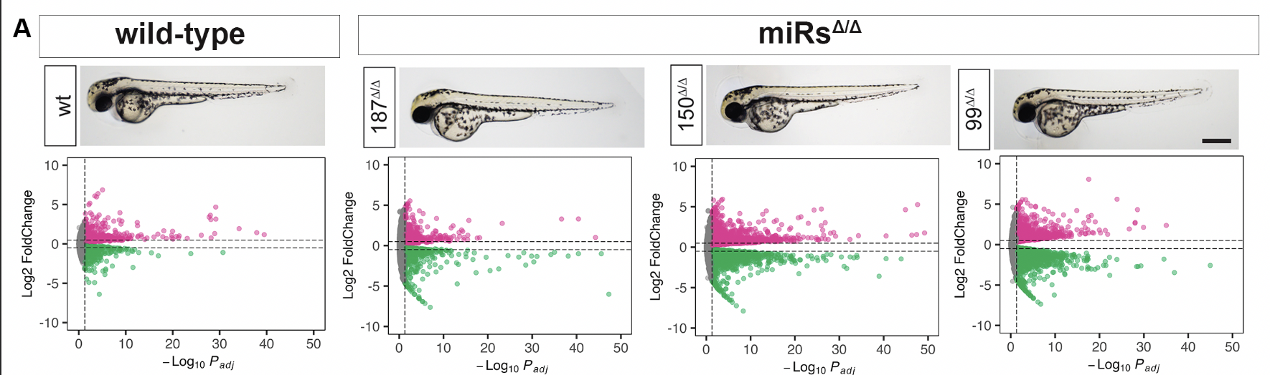
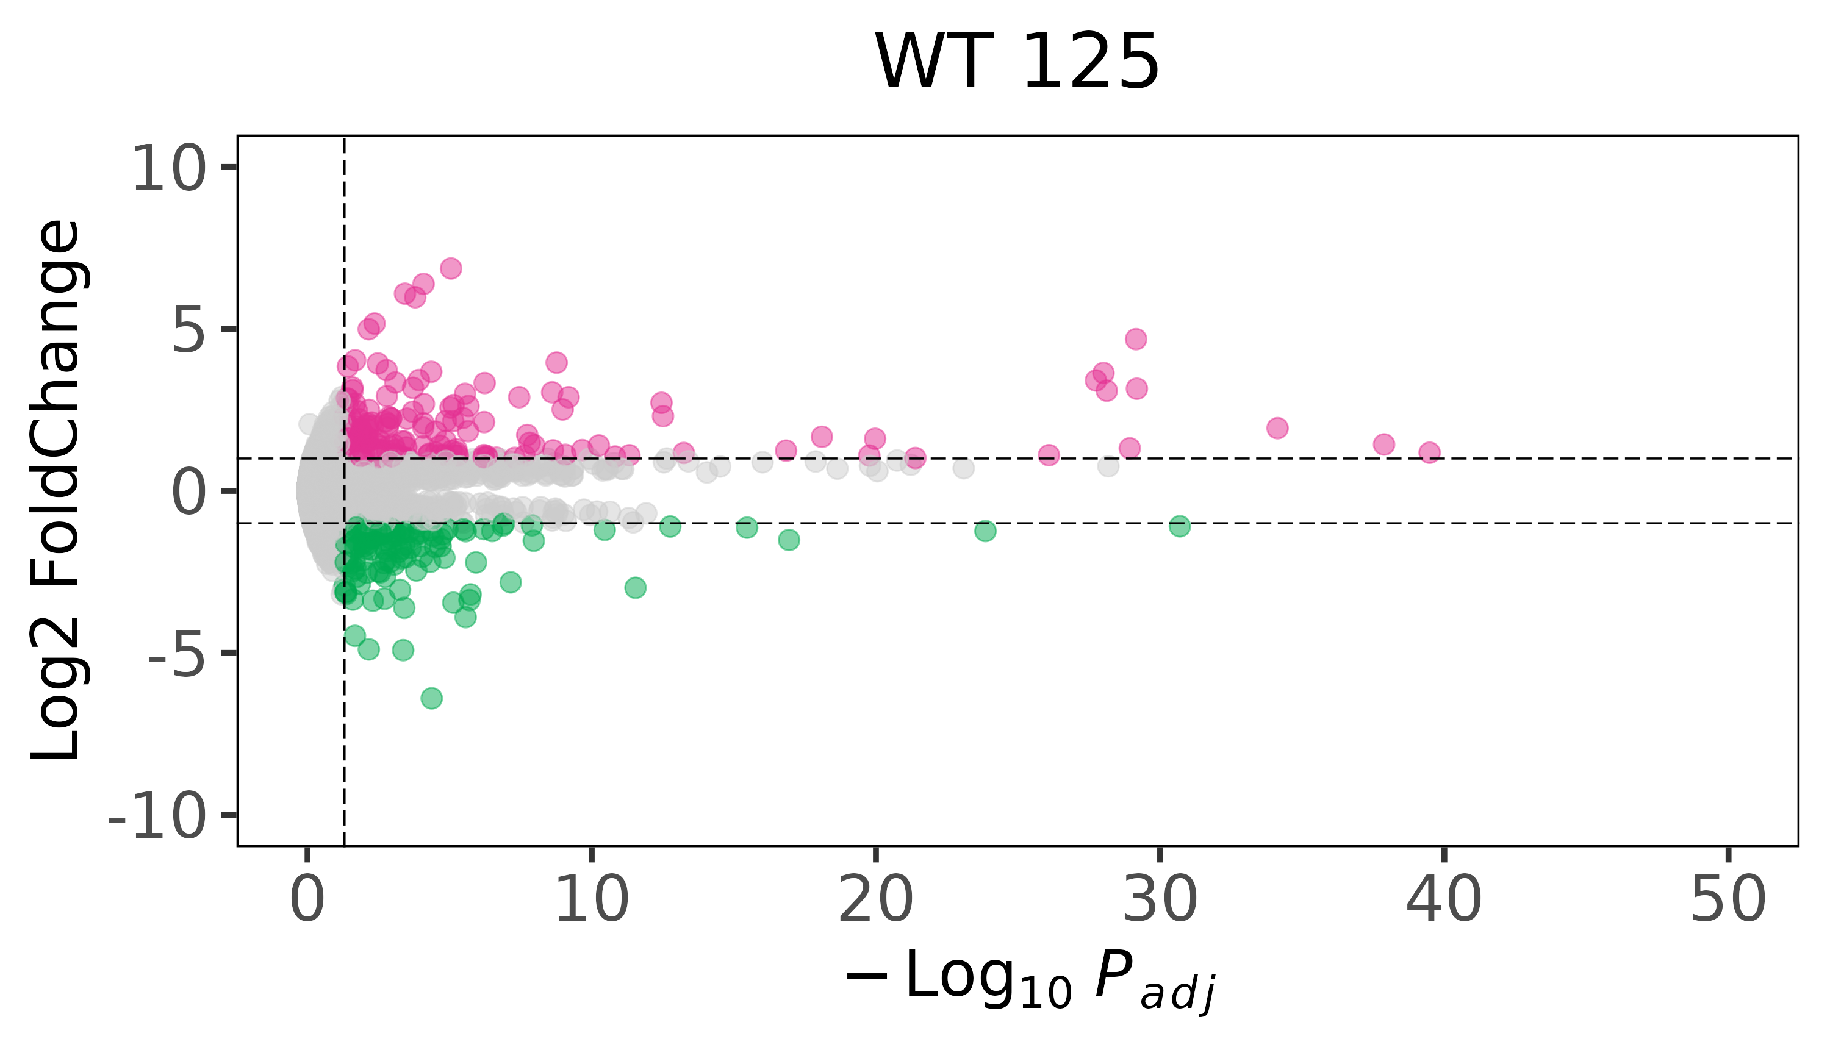
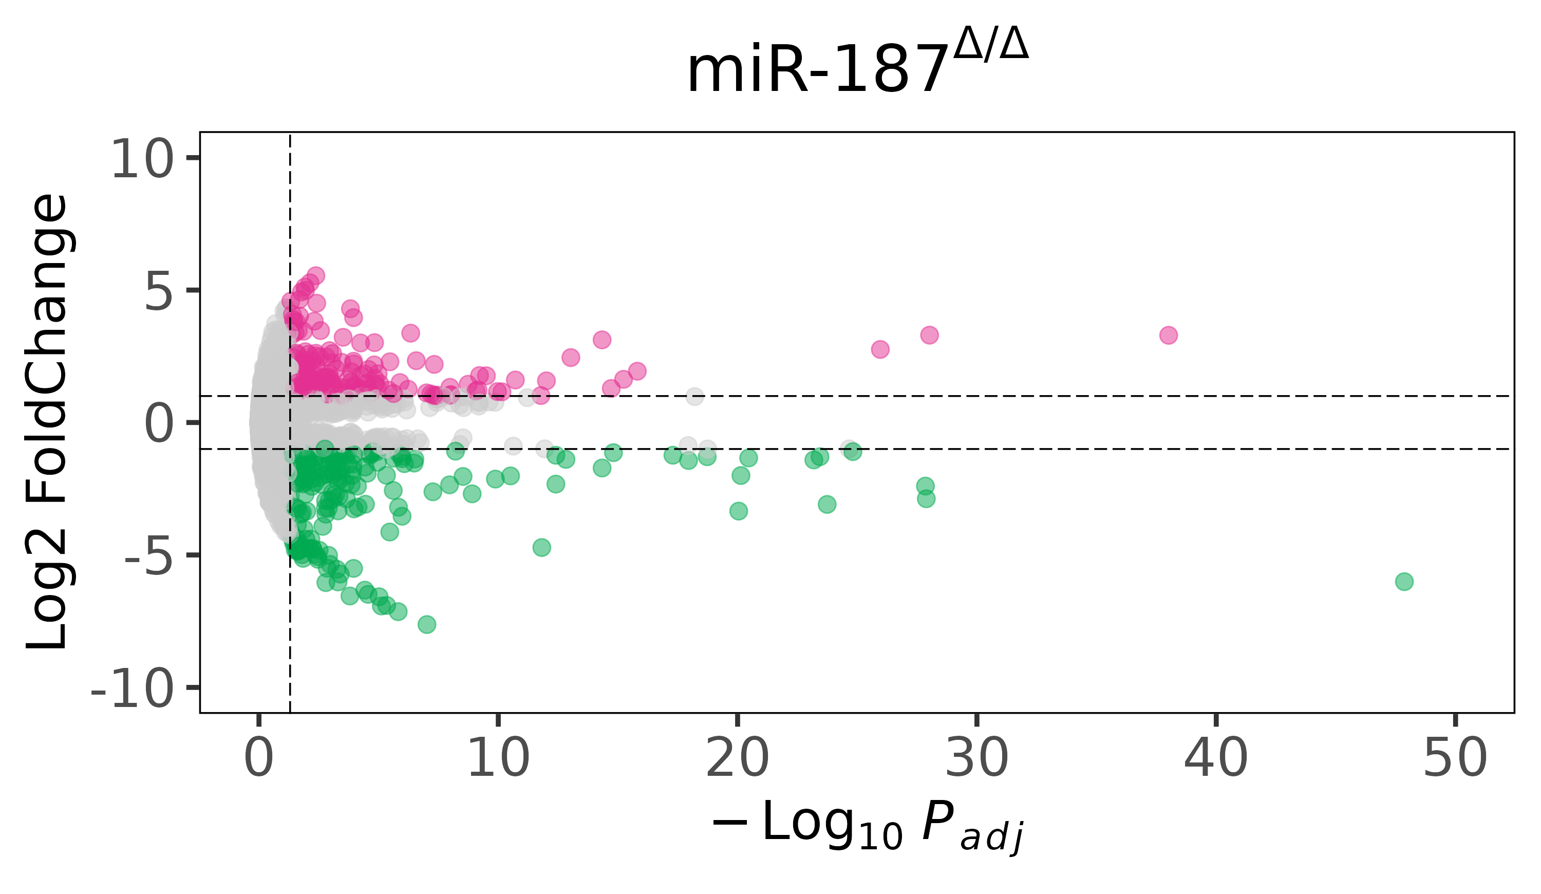
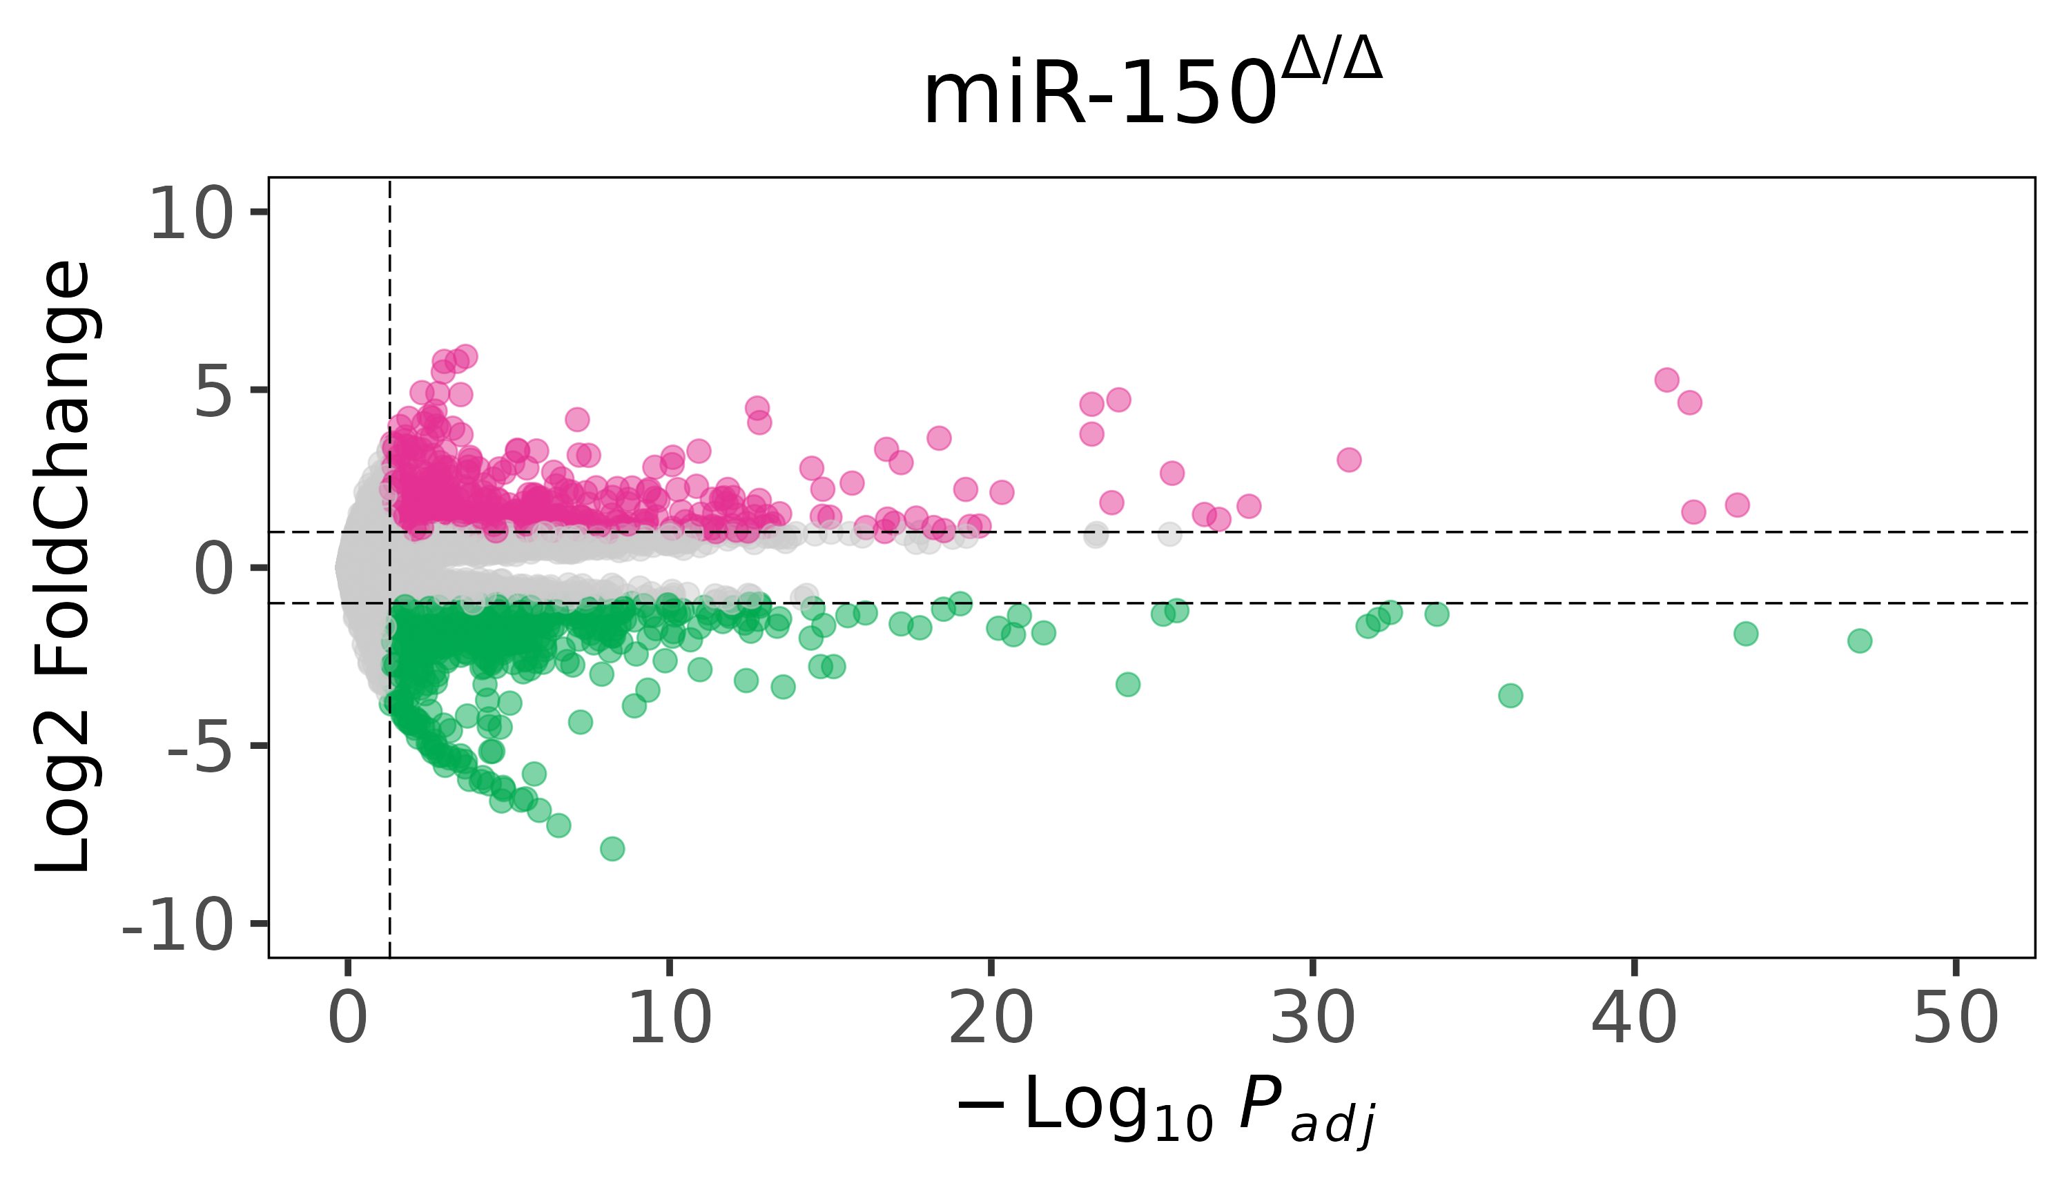
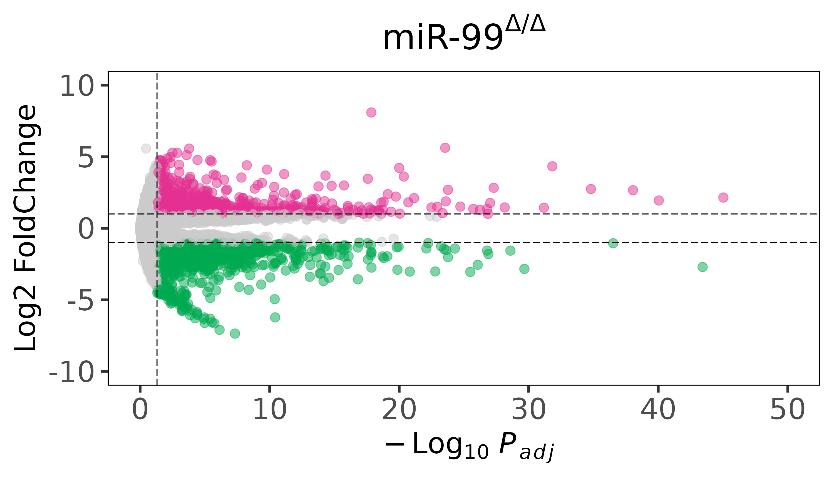
Weighted correlation network analysis (WGCNA) — Background
Most traditional workflows for transcriptomic data (RNA-Seq) focus on individual differentially expressed genes (DEGs)...
WT 2

Slide 6
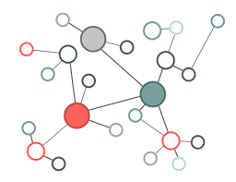
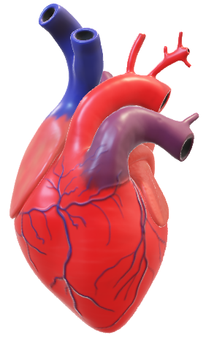
Weighted correlation network analysis (WGCNA) — Background
However, genes often work in a coordinated manner — in pathways, regulation networks, or functional units.
WT 2
Genotype
Phenotype
?
Molecularly

Slide 7
Weighted correlation network analysis (WGCNA) — Background
Weighted correlation network analysis (WGCNA)
→ Identifies modules of co-expressed genes.
→ Correlates these modules with traits or conditions.
→ Helps uncover systems-level insights and regulatory hubs.
Co-expressed genes
Similar function
Group A: Mutant
x
Group B: Wild-Type
Notes:
Dar somente o exemplo do projeto, explicar o pq de usar essa analise (hub driver genes), pq e importante

Slide 8
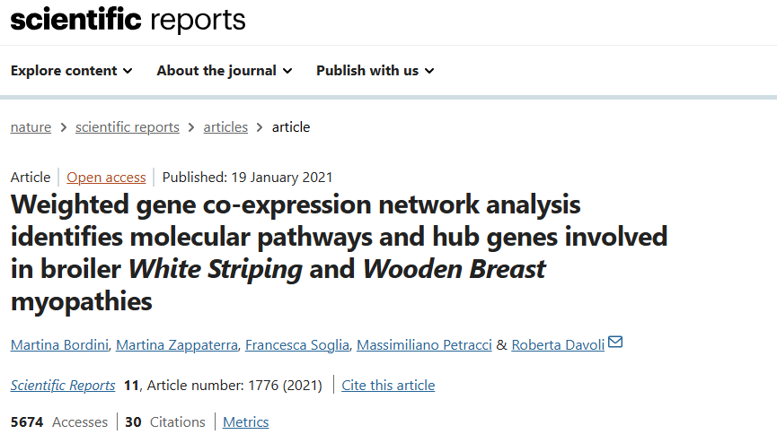
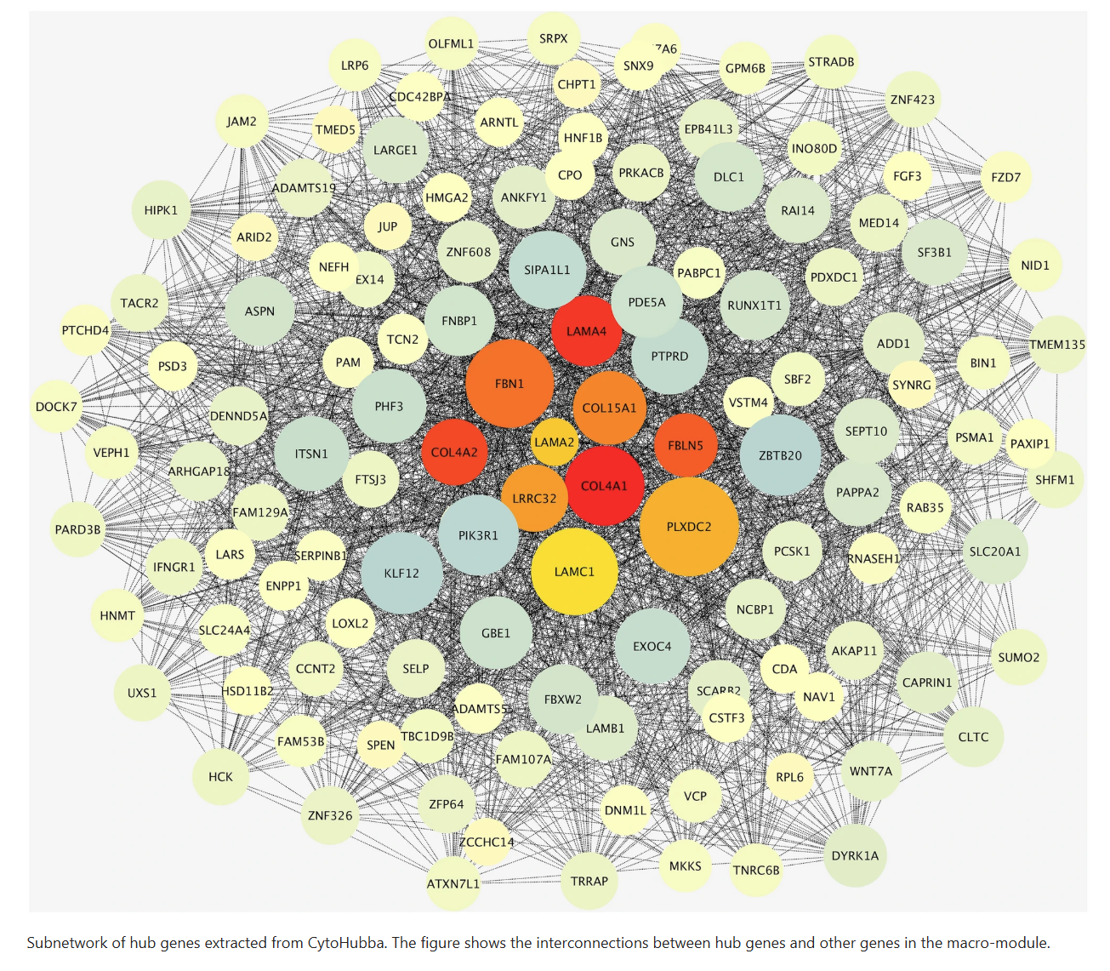
Weighted correlation network analysis (WGCNA) — Background
Notes:
To learn more

Slide 9
Weighted correlation network analysis (WGCNA) — Components
WGCNA components:
Construction of weighted gene correlation networks.
Identification of coexpression modules.
Association of genes with sample traits
Inference of intramodular hub genes as candidate drivers of phenotypes
Notes:
To learn more

Slide 10
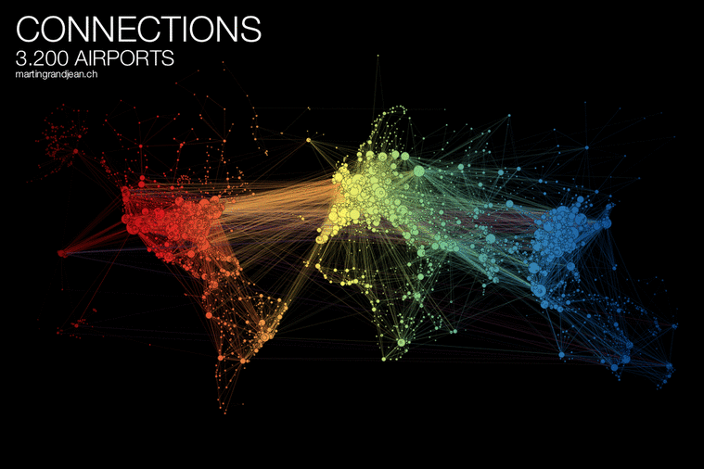
Weighted correlation network analysis (WGCNA) — GCN
Credit: Visualcapitalist
Notes:
To learn more

Slide 11
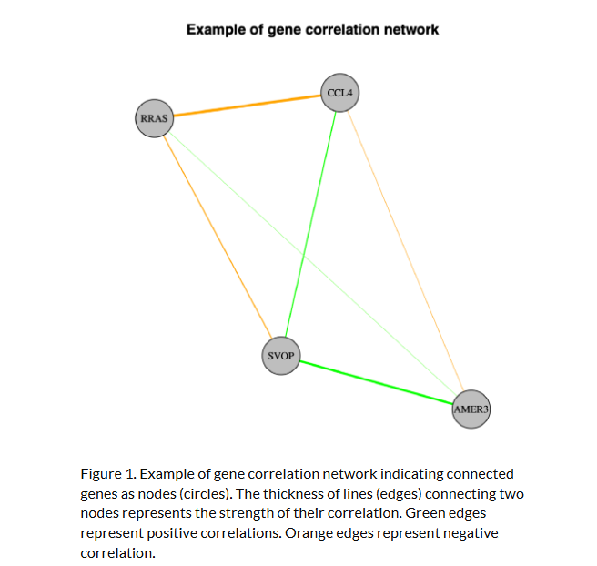
Weighted correlation network analysis (WGCNA) — GCN
Credit: Bigomics
Notes:
To learn more

Slide 12
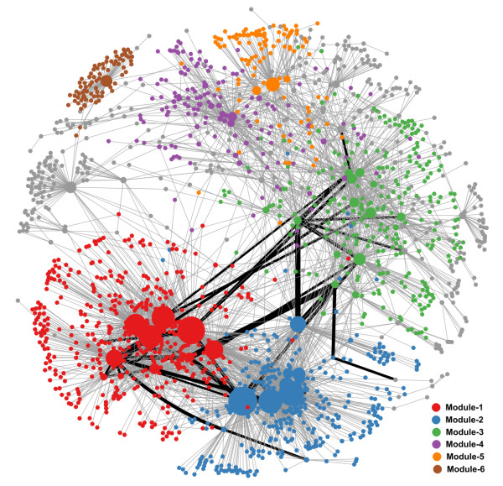
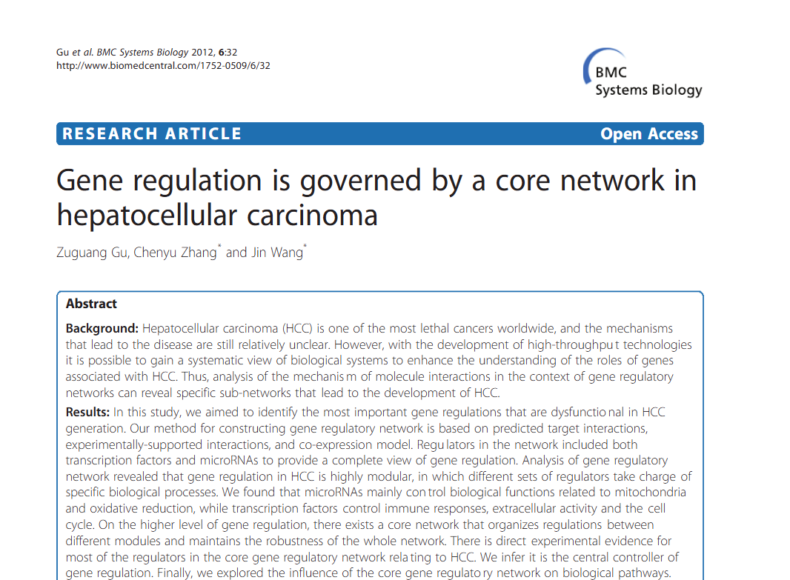
Weighted correlation network analysis (WGCNA) — GCN
The gene regulatory network in HCC. Different colors represent nodes in different network modules. Size of nodes is proportional to the out-degree of nodes. Black edges represent regulations in the core GRN, and the width of the edges in the core GRN are proportional to the edge-betweenness values calculated from the global GRN.
Notes:
To learn more

Slide 13
Weighted correlation network analysis (WGCNA) — Components
WGCNA components:
Construction of weighted gene correlation networks.
Identification of coexpression modules.
Association of genes with sample traits
Inference of intramodular hub genes as candidate drivers of phenotypes
Notes:
To learn more

Slide 14
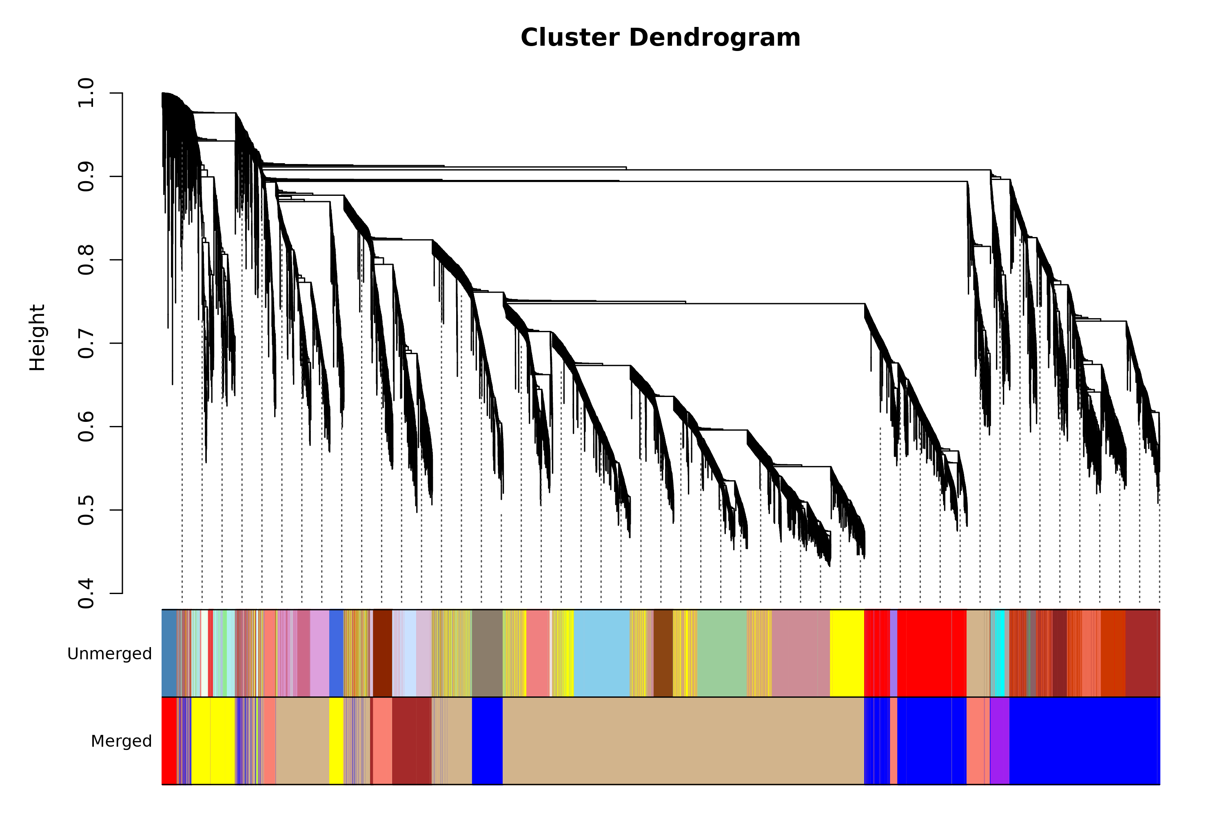
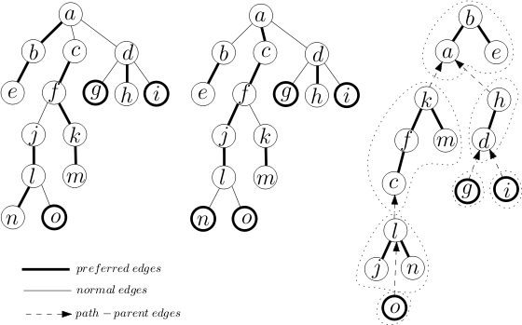
Weighted correlation network analysis (WGCNA) — Identifying Coexpression Modules
WGCNA groups genes with similar expression patterns into modules (unique ID and colour) based on their correlated structure.
Credit: Wikipedia
Modules are detected using methods like dynamic tree cut, which identifies clusters of genes with strong coexpression.
These modules serve as the basis for downstream analyses, such as correlation with phenotypic traits.
Notes:
To learn more

Slide 15
Weighted correlation network analysis (WGCNA) — Components
WGCNA components:
Construction of weighted gene correlation networks.
Identification of coexpression modules.
Association of genes with sample traits
Inference of intramodular hub genes as candidate drivers of phenotypes
Notes:
To learn more

Slide 16
Weighted correlation network analysis (WGCNA) — Components
Weighted correlation network analysis (WGCNA) — Link association with phenotype
After modules are defined, WGCNA summarizes each one using its module eigengene — a single value (PC) representing the overall expression trend of the module across all samples.
These eigengenes can be correlated with phenotypic traits (e.g., treatment, condition, tissue type) to identify modules associated with biological differences.
Once trait-associated modules are identified, we can explore why they are linked to the condition by analyzing:
their gene composition
enriched pathways or GO terms
and potential hub genes driving the signal
This step is key for interpreting the biological relevance of coexpression modules.
Notes:
To learn more

Slide 17
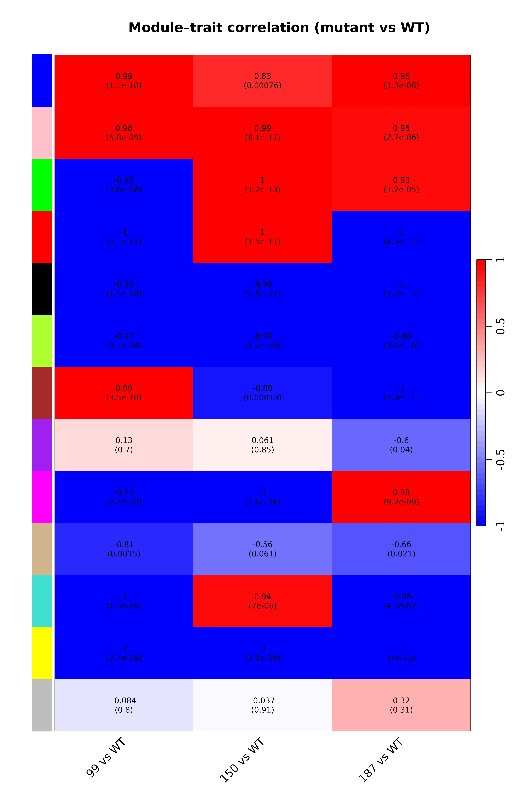
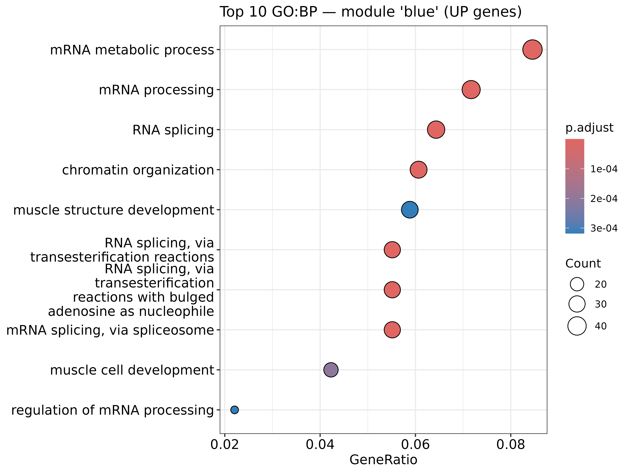
Weighted correlation network analysis (WGCNA) — Link association with phenotype
Notes:
To learn more

Slide 18
Weighted correlation network analysis (WGCNA) — Investigate candidate hub genes
WGCNA components:
Construction of weighted gene correlation networks.
Identification of coexpression modules.
Association of genes with sample traits
Inference of intramodular hub genes as candidate drivers of phenotypes
Notes:
To learn more

Slide 19
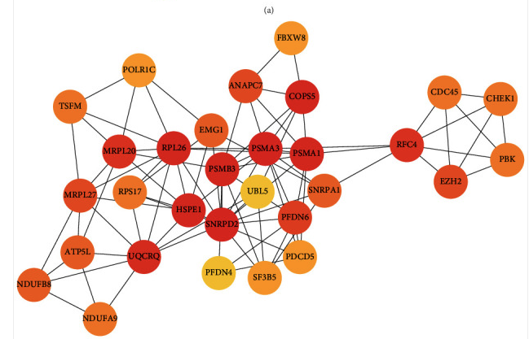
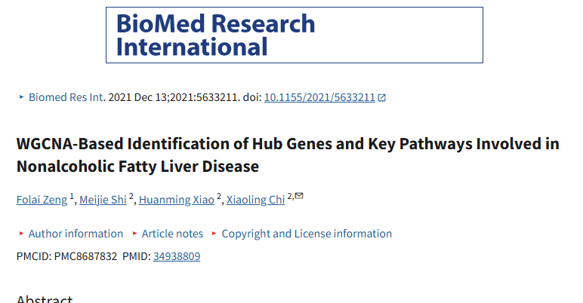
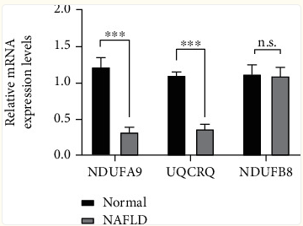
Weighted correlation network analysis (WGCNA) — Identify potential driver genes
Notes:
To learn more

Slide 20
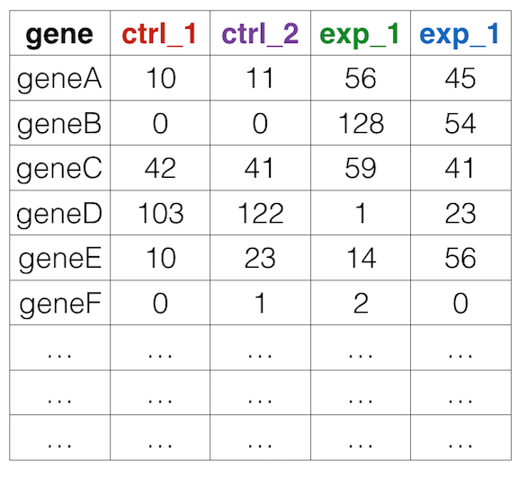
Weighted correlation network analysis (WGCNA) — Workflow
Pre-process data done previously!
Quality Control
.fastq files
Alignment
.bam files
Quantification
.txt files
Output:
Raw count matrix
Notes:
Deixar claro as partes que ja foram feitas anteriormente (light shade), check if I use VST and deseq2 together

Slide 21
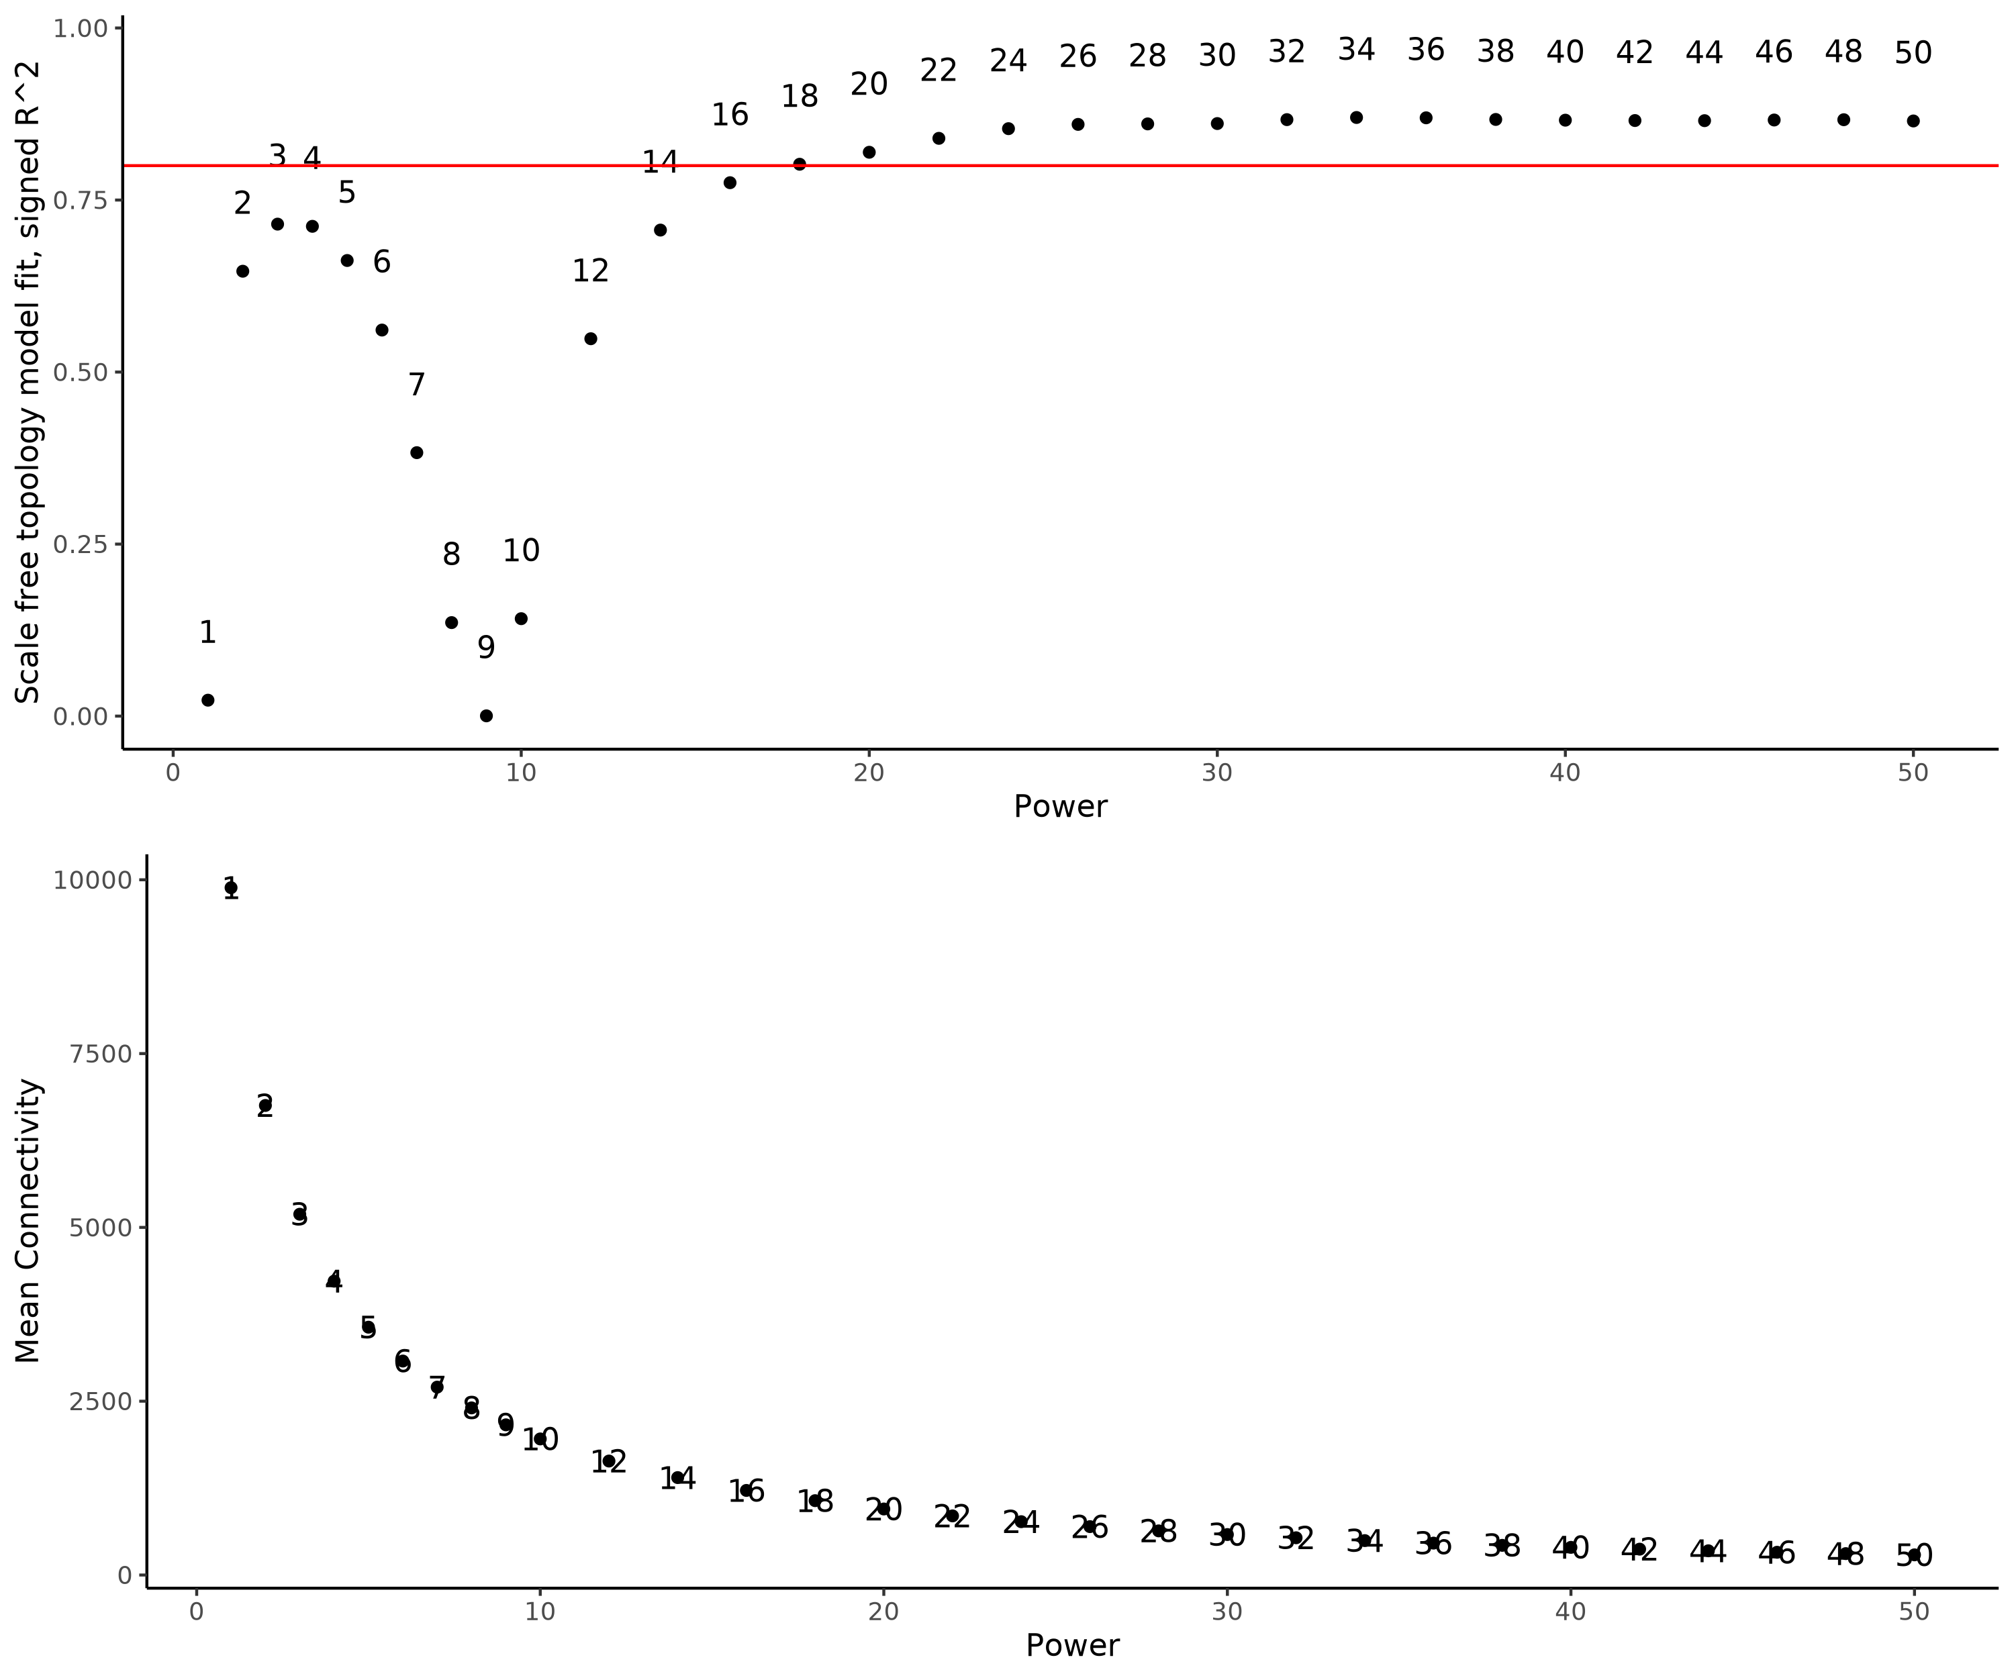
Weighted correlation network analysis (WGCNA) — Workflow
Soft-thresholding Power Selection
How strongly we want to highlight gene–gene connections?
Decision making: We use pickSoftThreshold() to find the optimal power (R² ≥ 0.8), that shapes the network into a scale-free topology, a common structure in biological systems where few genes act as hubs and most have fewer connections.
Notes:
Keep the slide, but do not showed it. Present the concept during the practical section

Slide 22
Weighted correlation network analysis (WGCNA) — Workflow
Input preparation
Merge samples per condition and create metadata
Raw count matrix
WITH ALL SAMPLES
From same experiment
Preprocessing
Filter low-quality genes
Normalize raw counts (VST, DESeq2)
Soft-thresholding Power Selection
Network Construction and Module Detection
blockwiseModules()
Module Eigengene Calculation
Relating Modules to Phenotype of Interest
Notes:
Raw count file with all samples of the same experiment in order to compared

Slide 23
Weighted correlation network analysis (WGCNA) — Good Practices
✅ Good practices
🔢 More replicates = more robust results
WGCNA performs best with 20 or more samples (explain this better). Small datasets can lead to unstable modules.
🧠 Unsupervised method – no DE filtering
DO NOT filter genes based on differential expression. WGCNA relies on global coexpression patterns, not pre-selected gene sets.
🧬 RNA-Seq-specific considerations:
🔽 Remove low-count genes (e.g., genes with near-zero expression across samples)
🔄 Normalize expression data
Use consistent methods across samples (e.g., VST from DESeq2, log2(RPKM+1), TMM, etc.)
⚠️ Correct batch effects
If present, adjust before network construction (e.g., using limma::removeBatchEffect or ComBat)
Notes:
To learn more

Slide 24

Questions?

Slide 25

Study Design
Data: RNA-Seq data of Peripheral Blood Mononuclear Cells (PBMCs) from a group of 17 COVID-19 subjects and 17 healthy controls (GSE152418)
Total samples = 34
Biological Question:
What are the genes or clusters of genes (modules) significantly associated with COVID-19 individuals?
Identify genes that are significantly associated with severe COVID-19 cases

Slide 26

Requirements
R (v4.1.1)
Rstudio (v1.4.1717)
R packages:
WGCNA (v1.71)
DESeq2 (v1.32.0)
GEOquery (v2.60.0)
Tidyverse (v1.3.1)
CorLevelPlot (v0.99.0)
gridExtra (v2.3)

Slide 27
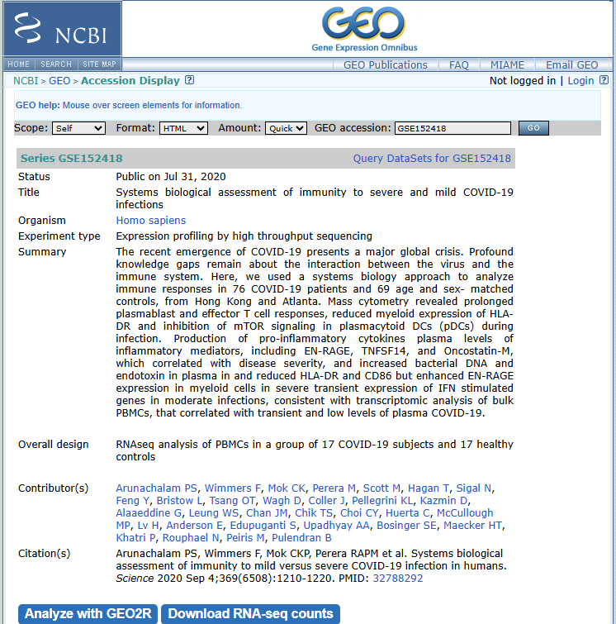
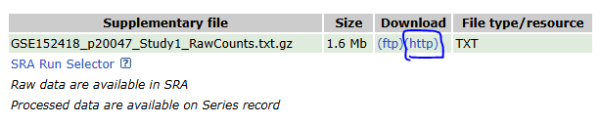
Requirements
Dataset
GSE152418

Slide 28

Submit your proposal!

